Slide 1

Contents
Uncertainty
What is Uncertainty
Causes of Uncertainty
Probabilistic Reasoning in AI
Bayes Theorem in AI
Bayesian Network in AI
Markov Model
Hidden Markov Model

Slide 2


What is Uncertainty ?

Slide 3
With this knowledge representation, we might write A→B, which means if A is true then B is true, but consider a situation where we are not sure about whether A is true or not then we cannot express this statement, this situation is called uncertainty.

Slide 4
Causes of uncertainty:
Information occurred from unreliable sources.
Experimental Errors
Equipment fault
Temperature variation
Climate change.

Slide 5

Probabilistic reasoning

Slide 6
Need of probabilistic reasoning in AI
When there are unpredictable outcomes.
When specifications or possibilities of predicates becomes too large to handle.
When an unknown error occurs during an experiment.

Slide 7
In probabilistic reasoning, there are two ways to solve problems with uncertain knowledge:
Bayes' rule
Bayesian Statistics

Slide 8
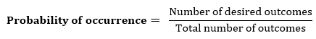
Probability:
0 ≤ P(A) ≤ 1, where P(A) is the probability of an event A.
P(A) = 0, indicates total uncertainty in an event A.
P(A) =1, indicates total certainty in an event A.

Slide 9
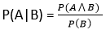
Conditional probability:
Let's suppose, we want to calculate the event A when event B has already occurred, "the probability of A under the conditions of B", it can be written as:

Slide 10
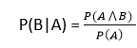
Where P(A⋀B) = Joint probability of A and B. P(B) = Marginal probability of B. If the probability of A is given and we need to find the probability of B, then it will be given as:

Slide 11
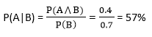
Example: In a class, there are 70% of the students like English and 40% of the students likes English and mathematics, and what is the percent of students like mathematics? Solution: Let, A is an event that a student likes Mathematics B is an event that a student likes English.

Slide 12
Bayes' theorem:
Bayes' theorem is also known as Bayes' rule, Bayes' law, or Bayesian reasoning, which determines the probability of an event with uncertain knowledge.
In probability theory, it relates the conditional probability and marginal probabilities of two random events.
It is a way to calculate the value of P(B|A) with the knowledge of P(A|B).
Bayes' theorem allows updating the probability prediction of an event by observing new information of the real world.

Slide 13
Bayes' theorem can be derived using product rule and conditional probability of event A with known event B: As from product rule we can write: P(A ⋀ B)= P(A|B) P(B) Similarly, the probability of event B with known event A: P(A ⋀ B)= P(B|A) P(A)

Slide 14

P(A|B) is known as posterior, which we need to calculate, and it will be read as Probability of hypothesis A when we have occurred an evidence B. P(B|A) is called the likelihood, in which we consider that hypothesis is true, then we calculate the probability of evidence. P(A) is called the prior probability, probability of hypothesis before considering the evidence. P(B) is called marginal probability, pure probability of an evidence.

Slide 15
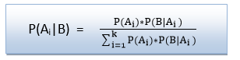
In the equation (a), in general, we can write P (B) = P(A)*P(B|Ai), hence the Bayes' rule can be written as:
Where A₁, A₂, A₃,........, A_{n} is a set of mutually exclusive and exhaustive events.

Slide 16
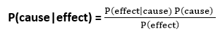
Applying Bayes' rule:
Example:
Question: From a standard deck of playing cards, a single card is drawn. The probability that the card is king is 4/52, then calculate posterior probability P(King|Face), which means the drawn face card is a king card.

Slide 17
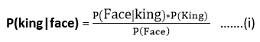
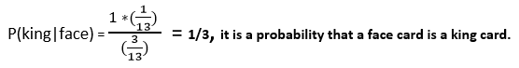
Solution:
P(king): probability that the card is King= 4/52= 1/13.
P(face): probability that a card is a face card= 3/13.
P(Face|King): probability of face card when we assume it is a king = 1
Putting all values in equation (i) we will get:

Slide 18
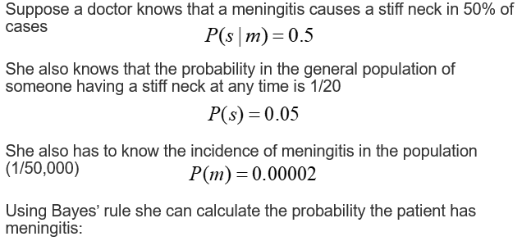
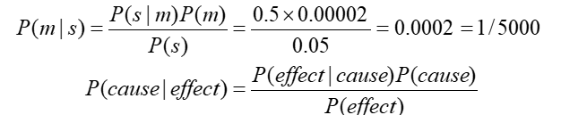

Slide 19
Application of Bayes' theorem in Artificial intelligence:
It is used to calculate the next step of the robot when the already executed step is given.
Baye’s theorem is helpful in weather forecasting.
It can solve the Monty Hall problem.
(https://betterexplained.com/articles/understanding-the-monty-hall-problem/ )

Slide 20
Bayesian Belief Network in artificial intelligence:
Bayesian Network can be used for building models from data and experts opinions, and it consists of two parts:
Directed Acyclic Graph.
Table of conditional probabilities.

Slide 21
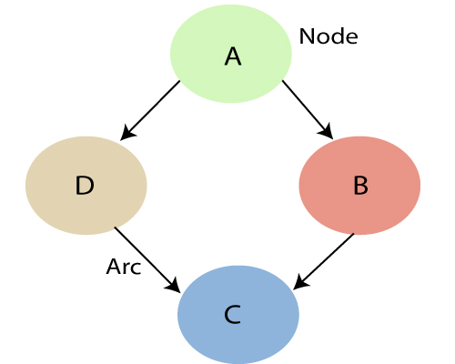
In the above diagram, A, B, C, and D are random variables represented by the nodes of the network graph.
If we are considering node B, which is connected with node A by a directed arrow, then node A is called the parent of Node B.
Node C is independent of node A.

Slide 22
Each node in the Bayesian network has condition probability distribution P(X_{i} |Parent(X_{i}) ), which determines the effect of the parent on that node. Bayesian network is based on Joint probability distribution and conditional probability. So let's first understand the joint probability distribution: A Bayesian network is a directed acyclic graph in which each edge corresponds to a conditional dependency, and each node corresponds to a unique random variable.

Slide 23
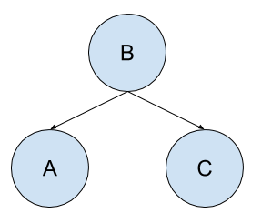
Consider a problem with three random variables: A, B, and C. A is dependent upon B, and C is dependent upon B.
We can state the conditional dependencies as follows:
A is conditionally dependent upon B, e.g. P(A|B)
C is conditionally dependent upon B, e.g. P(C|B)
We know that C and A have no effect on each other.
We can also state the conditional independencies as follows:
A is conditionally independent from C: P(A|B, C)
C is conditionally independent from A: P(C|B, A)
the random variables are each assigned a node, and the conditional probabilities are stated as directed connections between the nodes.
A is unaffected by C and can be calculated from A given B alone, P(A|B)
B is unaffected by A and C and has no parents; we can simply state the conditional independence of B from A and C as P(B).

Slide 24
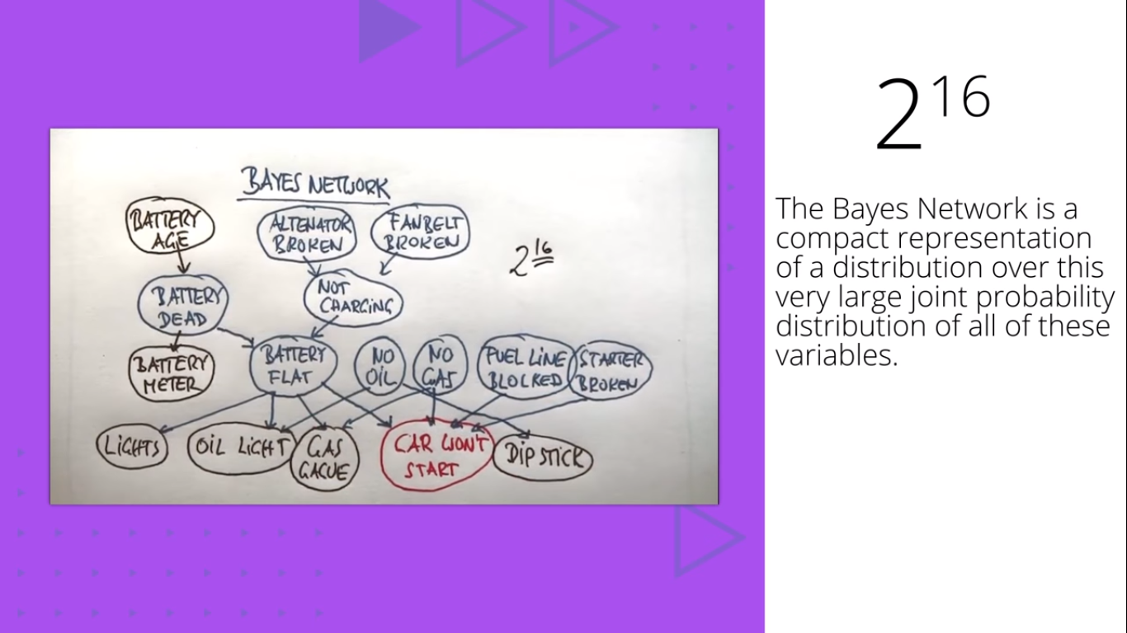

Slide 25
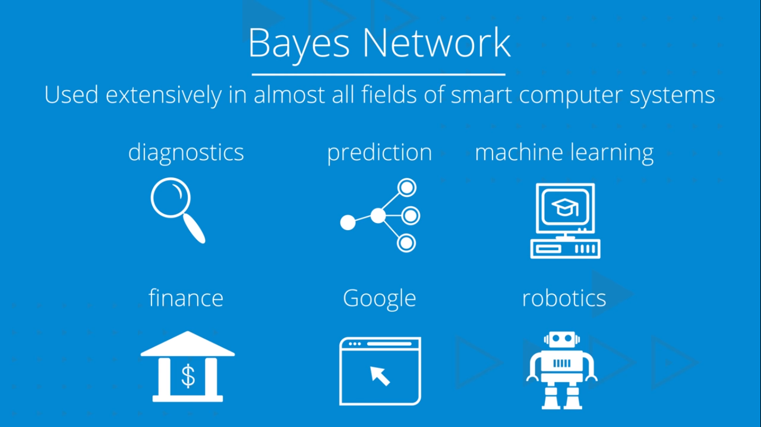

Slide 26
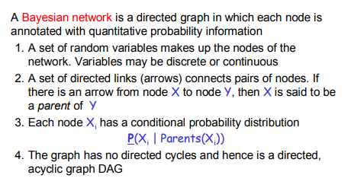
Bayesian Network

Slide 27
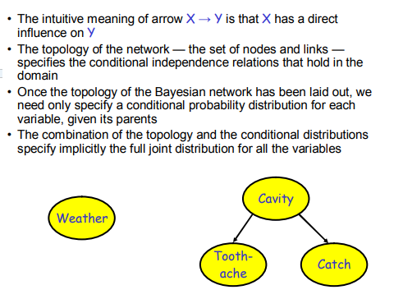

Slide 28
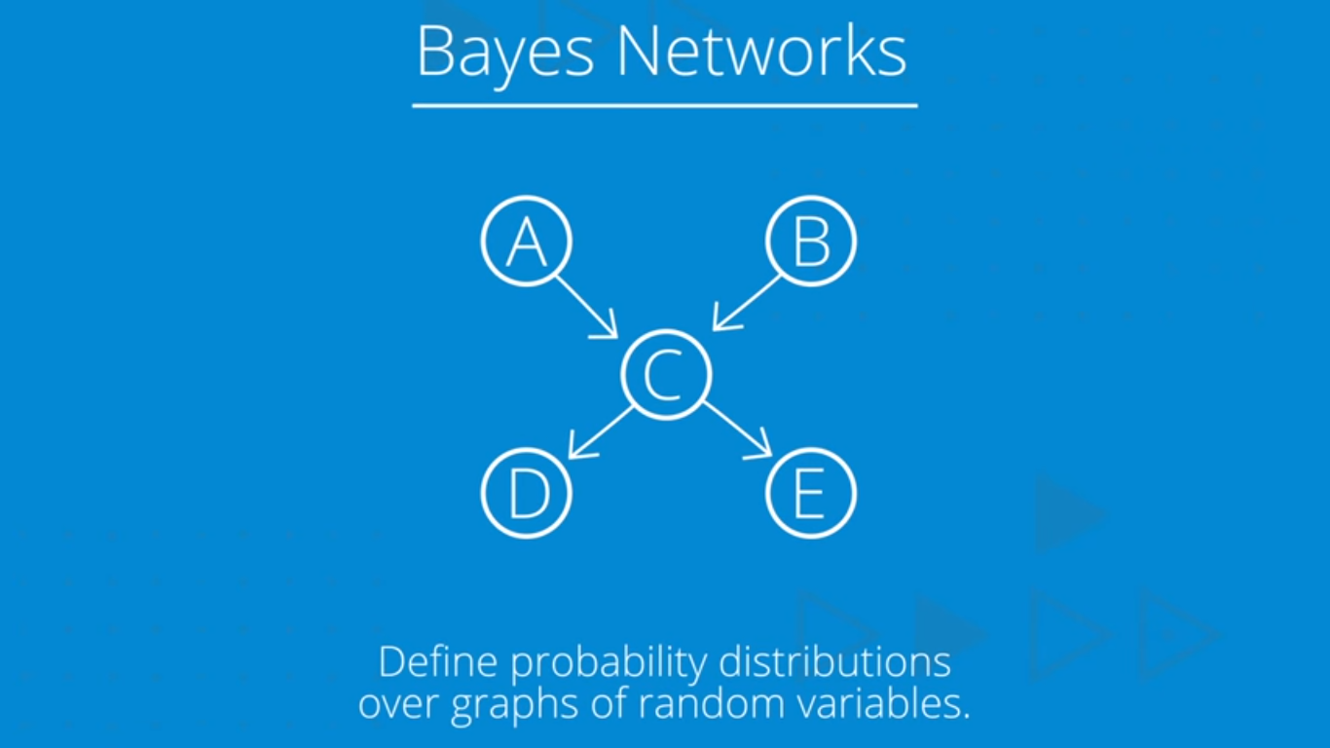

Slide 29
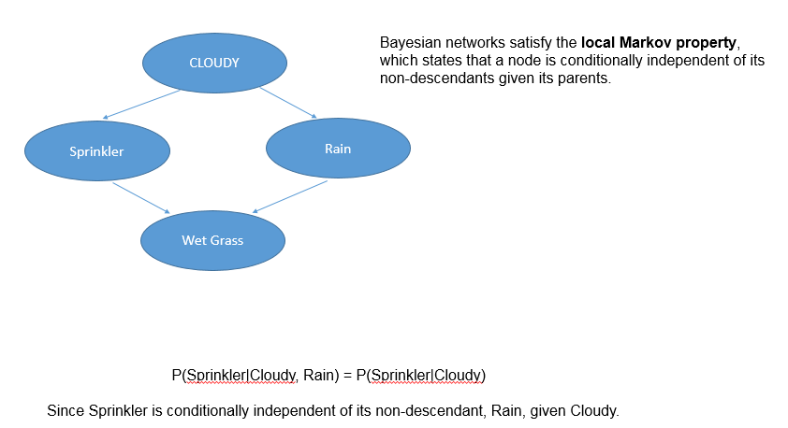

Slide 30
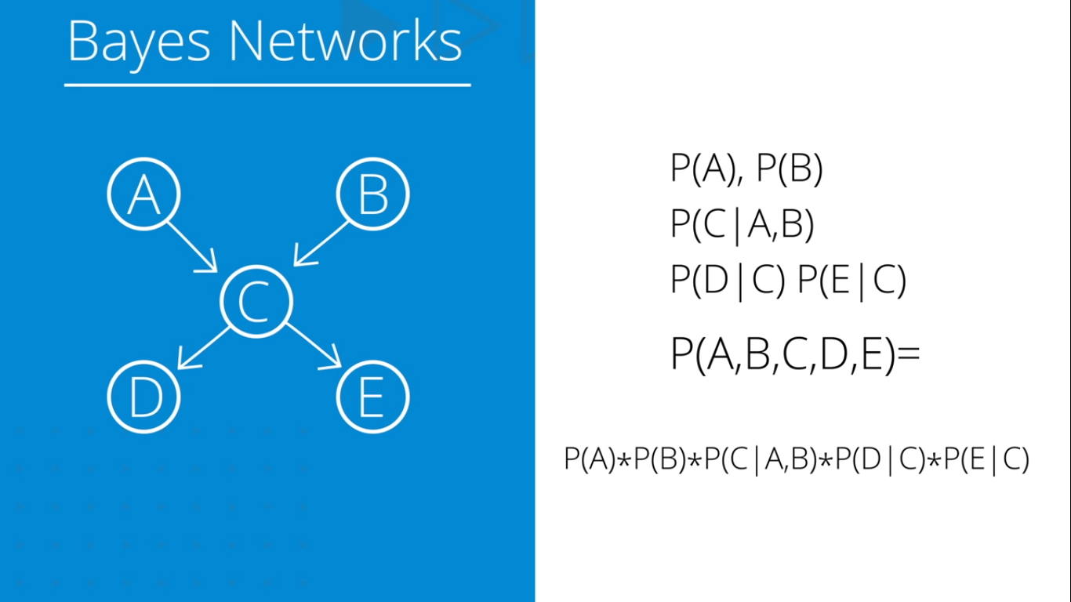

Slide 31
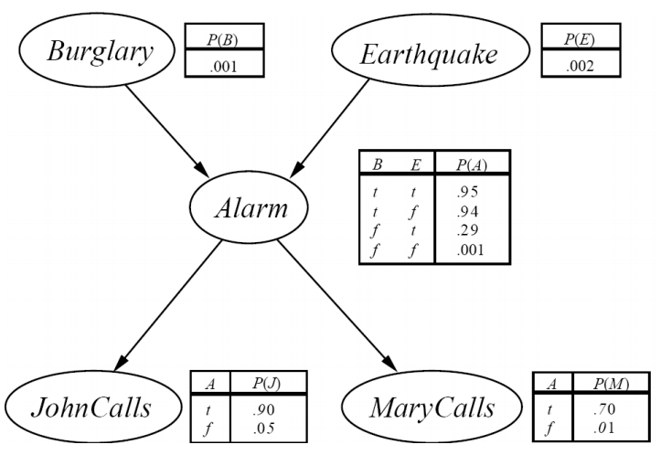

Slide 32
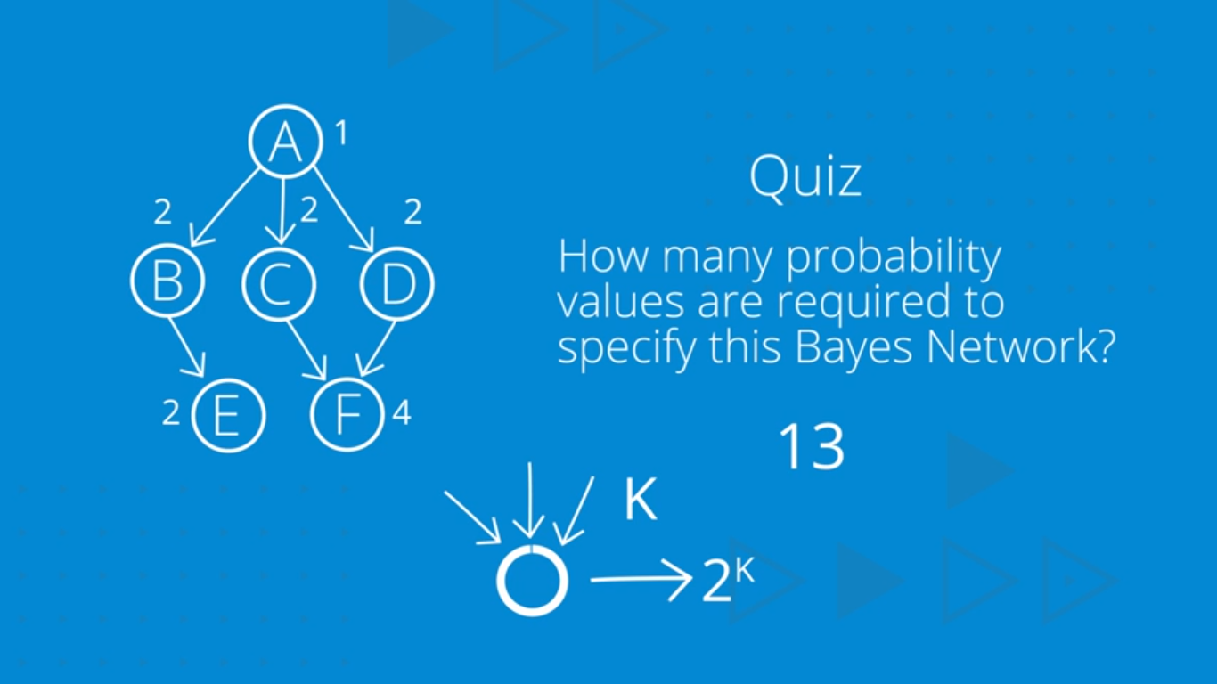

Slide 33
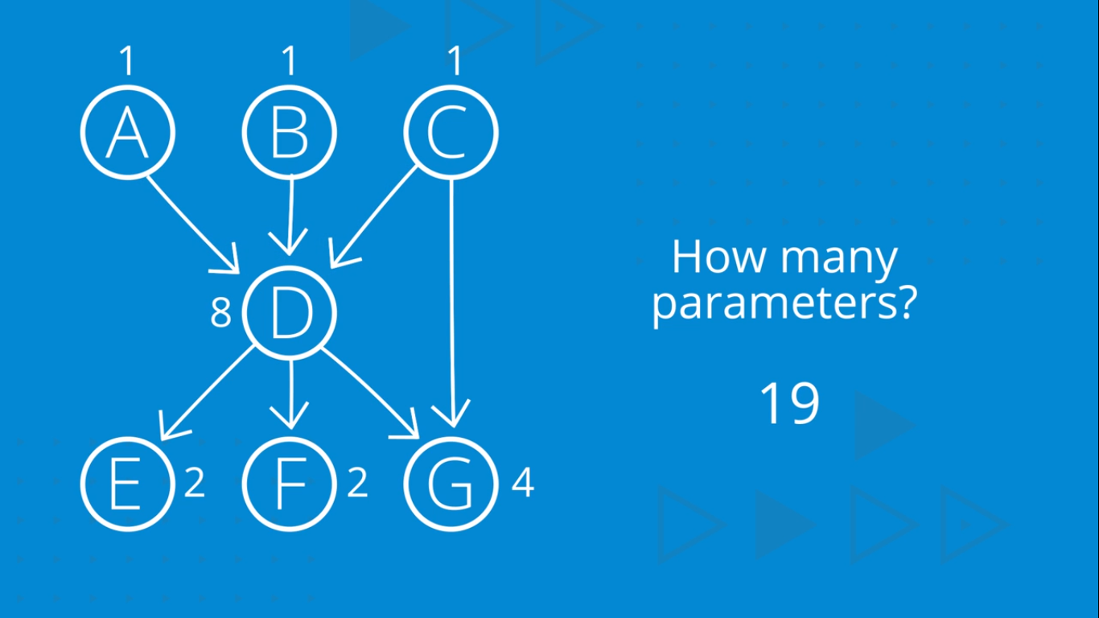

Slide 34
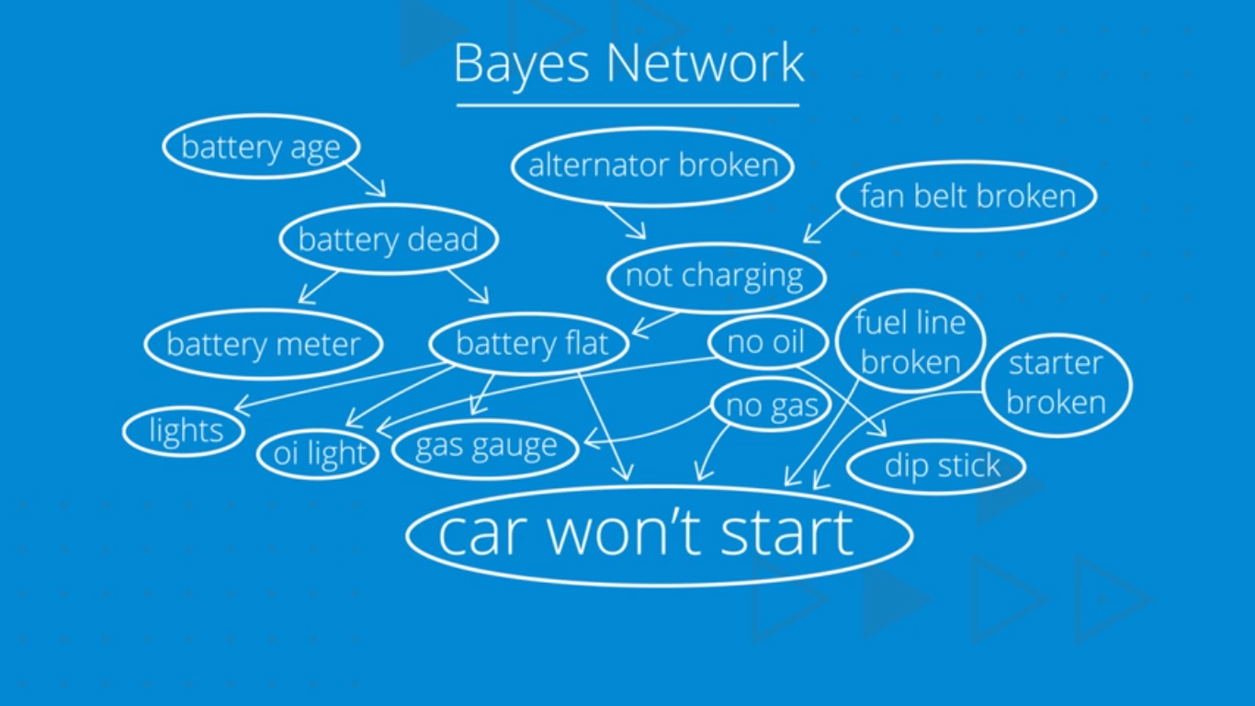

Slide 35
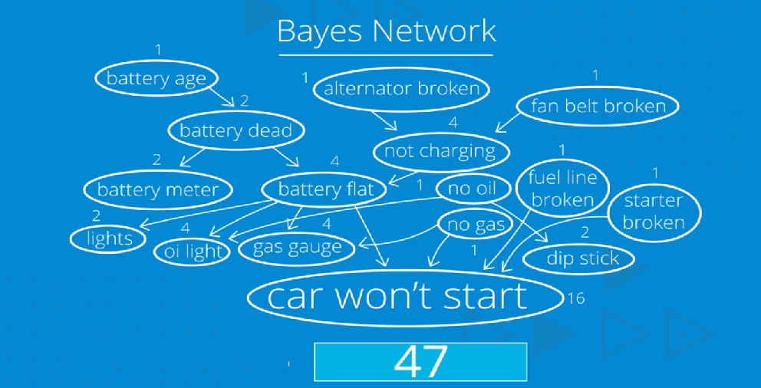

Slide 36
Three Basic Types Of Probabilities
Joint probability: Likelihood of a completely specified state of events, e.g. P(ABCDE)
Marginal probability: Likelihood of an incompletely specified state of events, e.g. P(ACD) or P(E)
Conditional probability: Likelihood of an event given some known information, e.g. P(A|C) or P(DE|AB)

Slide 37
Joint probability distribution:
If we have variables x1, x2, x3,....., xn, then the probabilities of a different combination of x1, x2, x3.. xn, are known as Joint probability distribution.
P[x₁, x₂, x₃,....., x_{n}], it can be written as the following way in terms of the joint probability distribution.
= P[x₁| x₂, x₃,....., x_{n}]P[x₂, x₃,....., x_{n}]
= P[x₁| x₂, x₃,....., x_{n}]P[x₂|x₃,....., x_{n}]....P[x_{n-1}|x_{n}]P[x_{n}].

Slide 38
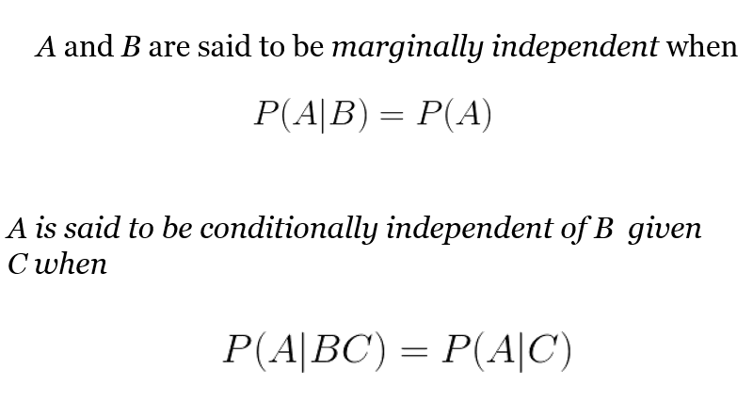

Slide 39
Markov Models
Markov chains, named after Andrey Markov, are mathematical systems that hop from one "state" (a situation or set of values) to another.
For example, if you made a Markov chain model of a baby's behavior, you might include "playing," "eating", "sleeping," and "crying" as states, which together with other behaviors could form a 'state space': a list of all possible states.
In addition, on top of the state space, a Markov chain tells you the probabilitiy of hopping, or "transitioning," from one state to any other state---e.g., the chance that a baby currently playing will fall asleep in the next five minutes without crying first.
Markov chain property: probability of each subsequent state depends only on what was the previous state:
To define Markov model, the following probabilities have to be specified:
Transition probabilities
Initial probabilities
In a Markov chain, the future depends only upon the present: NOT upon the past

Slide 40
Example of Markov Model
0.3
0.7
Rain
Dry
0.2
0.8
Two states : ‘Rain’ and ‘Dry’.
Transition probabilities:
P(‘Rain’|‘Rain’)=0.3 ,
P(‘Dry’|‘Rain’)=0.7 ,
P(‘Rain’|‘Dry’)=0.2,
P(‘Dry’|‘Dry’)=0.8
Initial probabilities: say P(‘Rain’)=0.4 , P(‘Dry’)=0.6 .

Slide 41
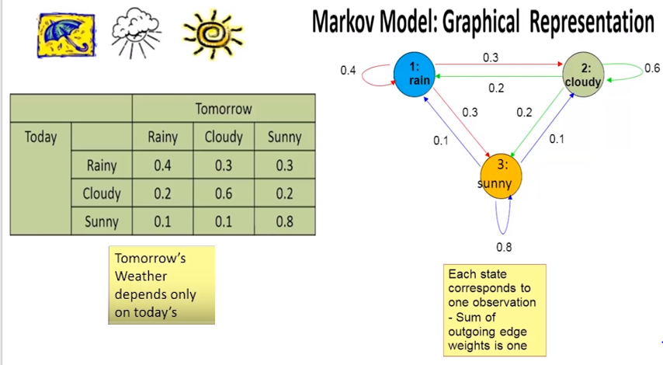

Slide 42
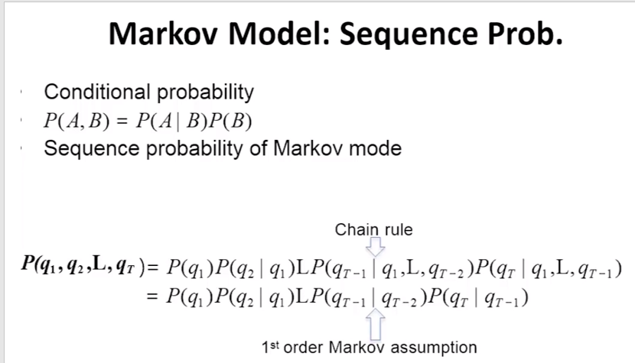

Slide 43
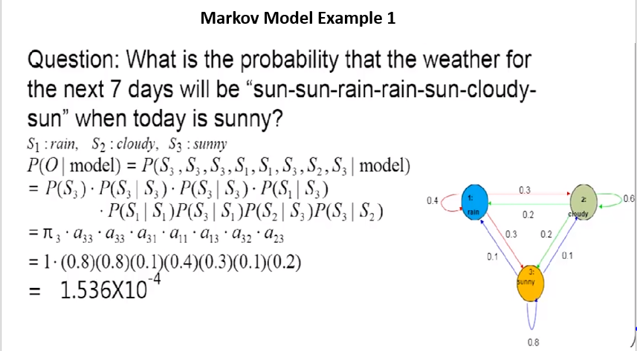

Slide 44
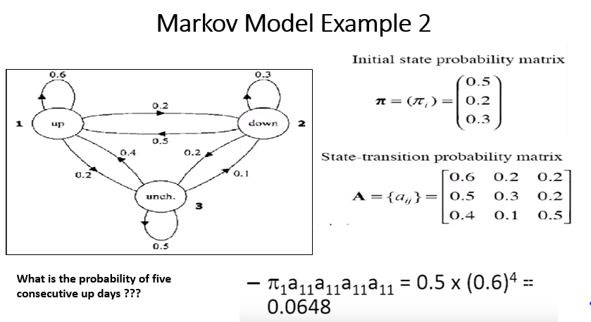

Slide 45
Hidden Markov Model
Hidden Markov Model (HMM) is a statistical Markov model in which the system being modeled is assumed to be a Markov process with unobserved (i.e. hidden) states.
Hidden Markov models are especially known for their application in reinforcement learning and temporal pattern recognition such as speech, handwriting, gesture recognition, part-of-speech tagging, musical score following, partial discharges and bioinformatics.

Slide 46
Terminology in HMM
The term hidden refers to the first order Markov process behind the observation.
Observation refers to the data we know and can observe. Markov process is shown by the interaction between “Rainy” and “Sunny” in the below diagram and each of these are HIDDEN STATES.
Refer the figure in next slide:

Slide 47
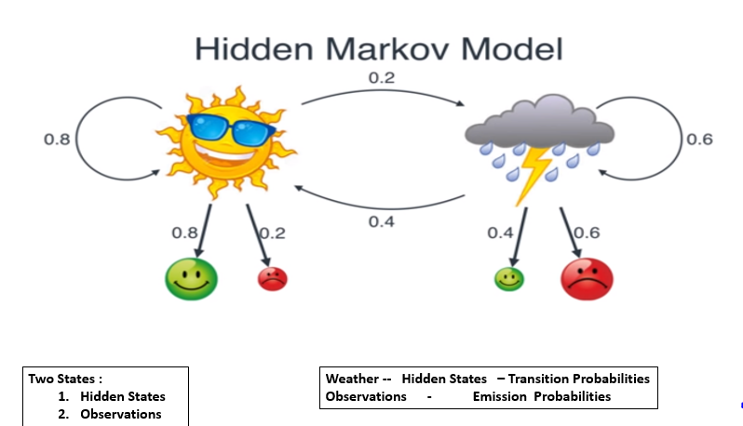

Slide 48
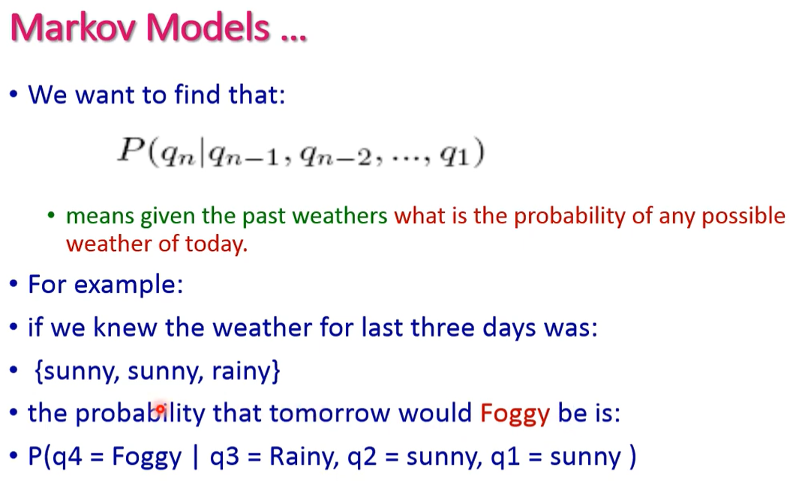

Slide 49
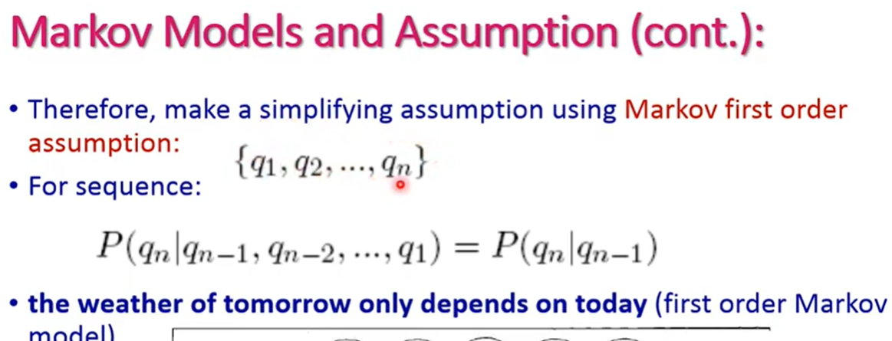
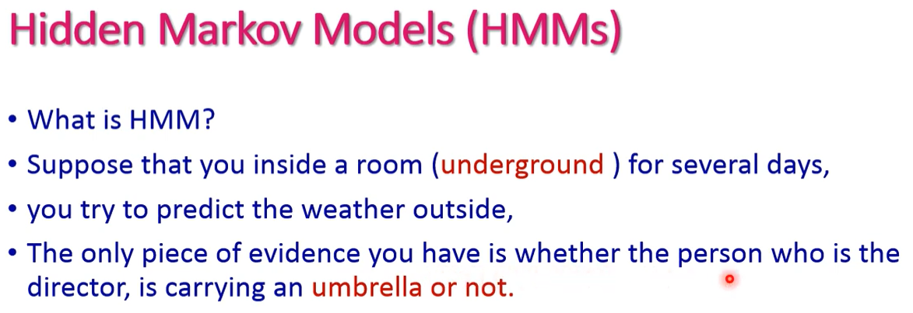

Slide 50
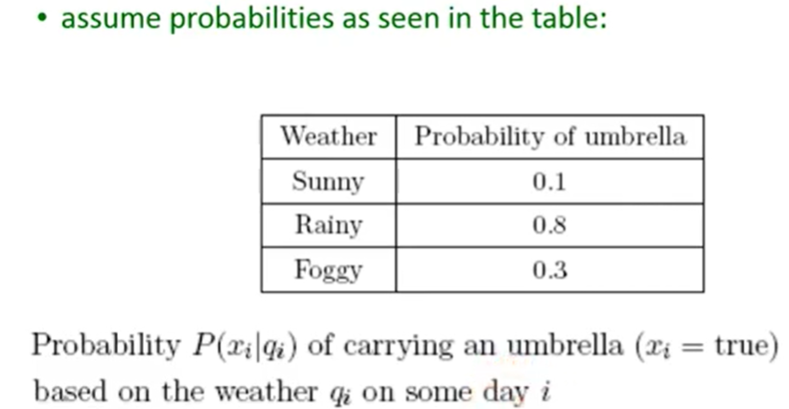
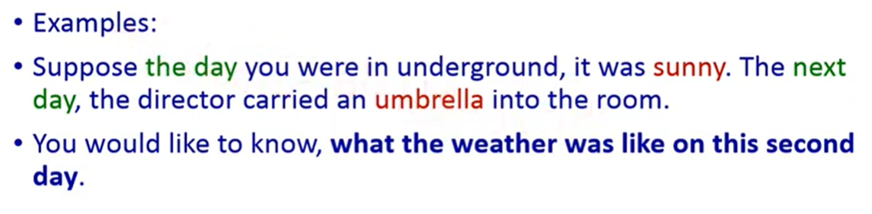

Slide 51
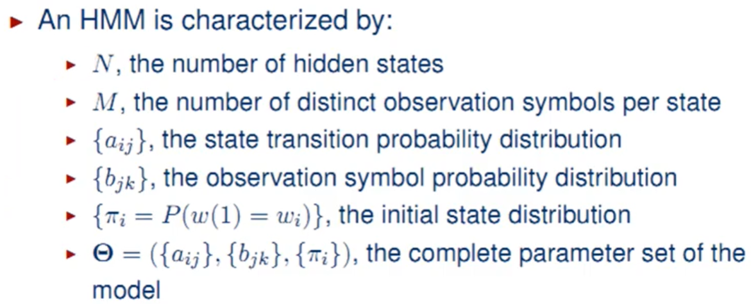

Slide 52
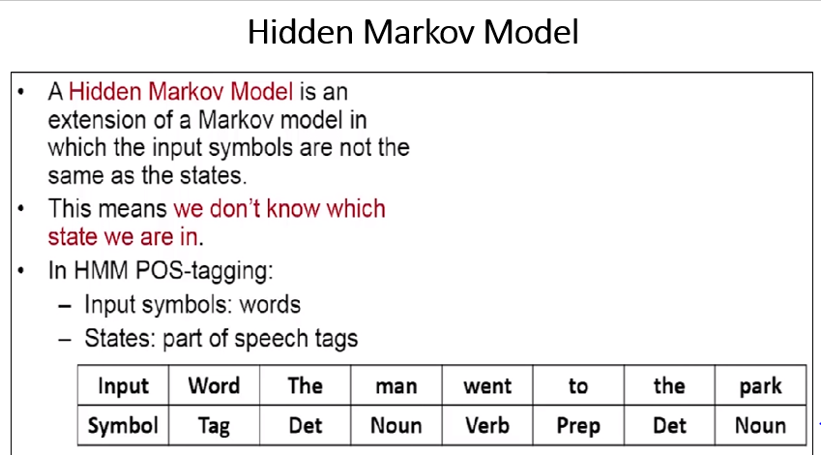
Notes:
Det- determiner is a word that introduces a noun

Slide 53
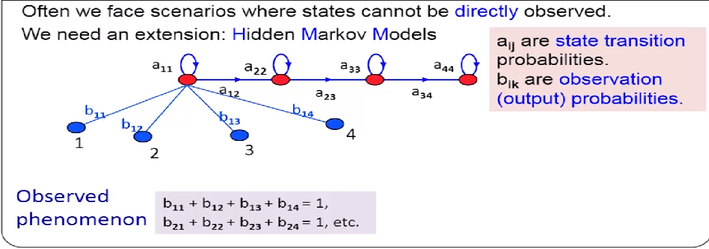

Slide 54
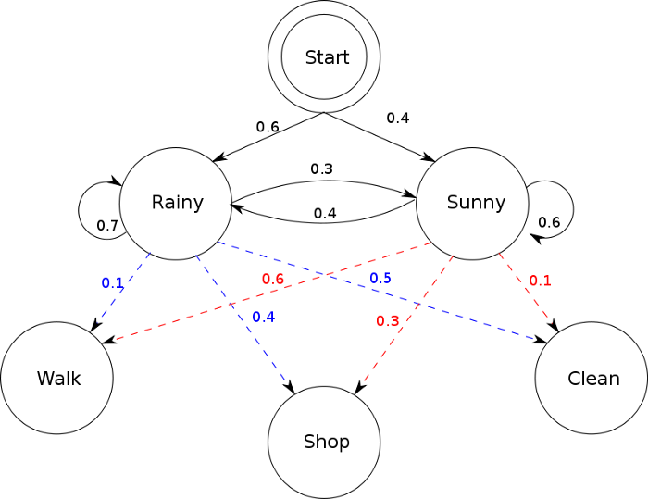
OBSERVATIONS are known data and refers to “Walk”, “Shop”, and “Clean” in the above diagram. In machine learning sense, observation is our training data, and the number of hidden states is our hyper parameter for our model. Evaluation of the model will be discussed later.

Slide 55
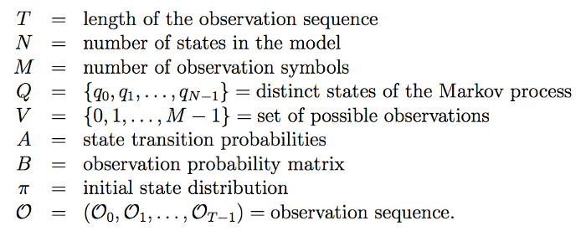

Slide 56
T = don’t have any observation yet, N = 2, M = 3, Q = {“Rainy”, “Sunny”}, V = {“Walk”, “Shop”, “Clean”} State transition probabilities are the arrows pointing to each hidden state. Observation probability matrix are the blue and red arrows pointing to each observations from each hidden state. The matrix are row stochastic meaning the rows add up to 1.
Notes:
A right stochastic matrix is a real square matrix, with each row summing to 1. A left stochastic matrix is a real square matrix, with each column summing to 1

Slide 57
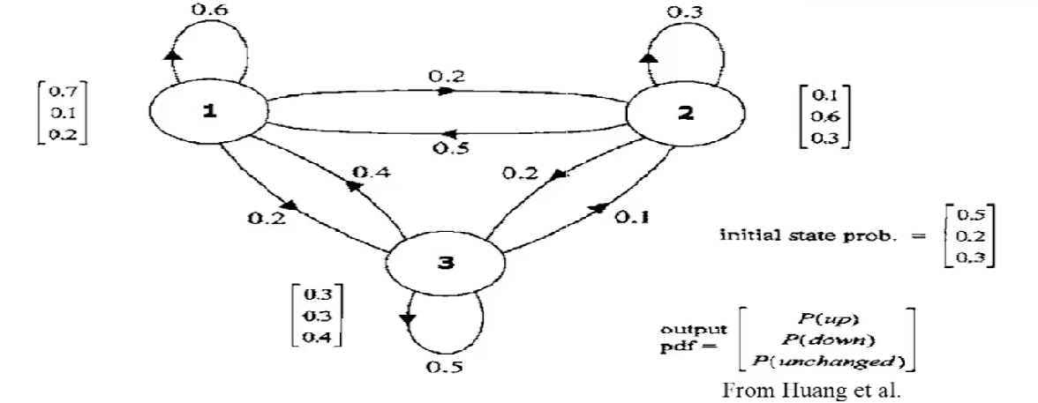

Slide 58
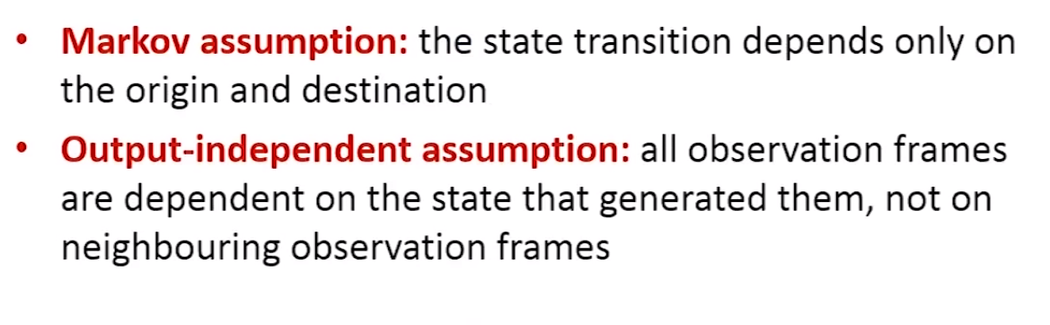
HMM : Assumptions

Slide 59
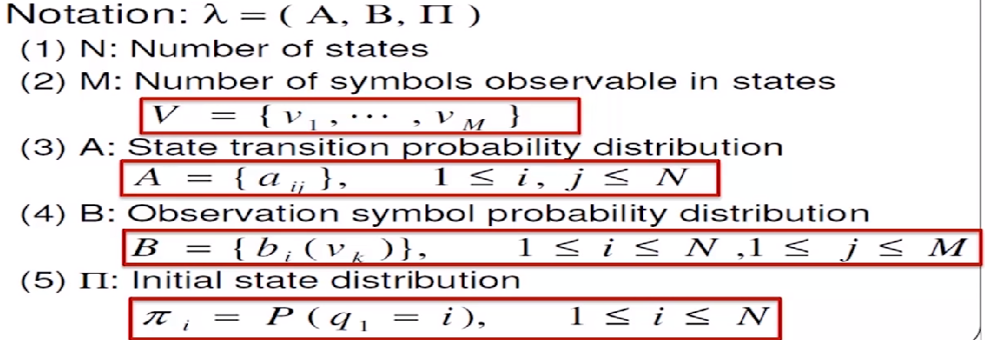
HMM : Definition

Slide 60
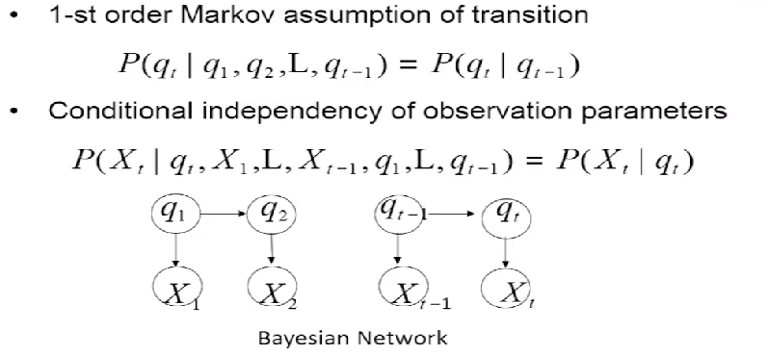
HMM : Dependency Structure

Slide 61
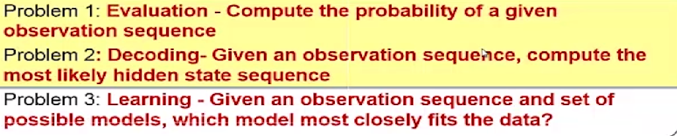
Problems in HMM

Slide 62
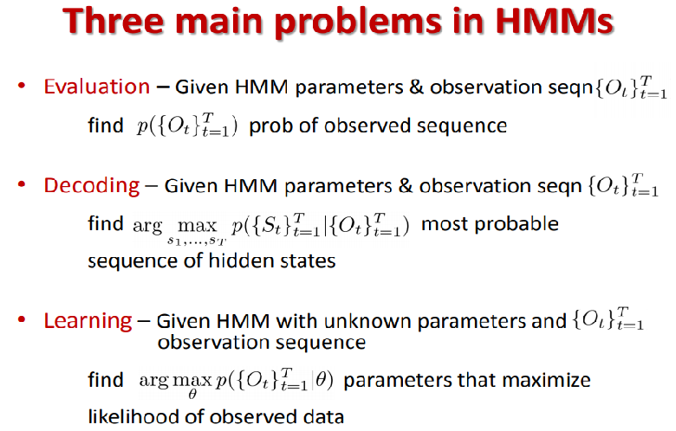

Slide 63
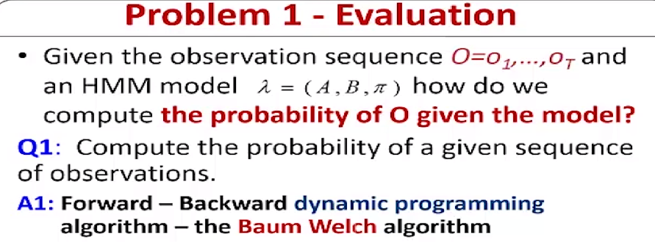

Slide 64
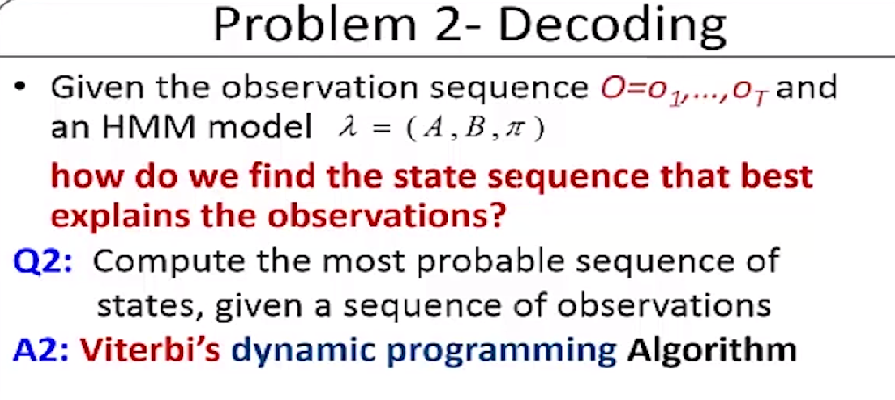

Slide 65
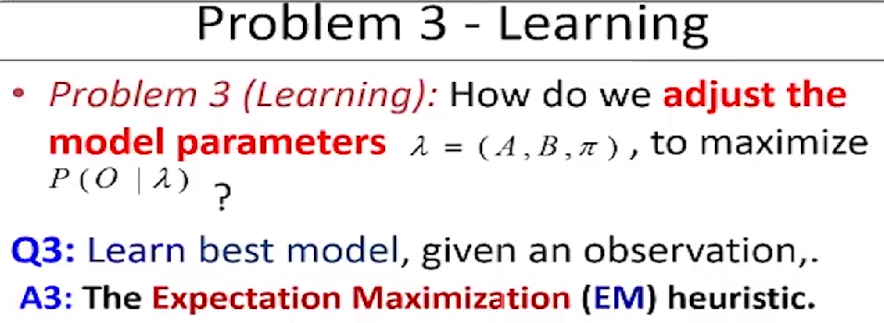

Slide 66

Next slide: Additional examples of probability and Bayes theorem

Slide 67

Probability of a Single Event
Throw 2 dice. What is the probability that the sum of the two dice will be 6? To solve this problem, list all the possible outcomes. There are 36 of them since each die can come up one of six ways. The 36 possibilities are shown below.
Die 1 | Die 2 | Total |  | Die 1 | Die 2 | Total |  | Die 1 | Die 2 | Total
1 | 1 | 2 |  | 3 | 1 | 4 |  | 5 | 1 | 6
1 | 2 | 3 |  | 3 | 2 | 5 |  | 5 | 2 | 7
1 | 3 | 4 |  | 3 | 3 | 6 |  | 5 | 3 | 8
1 | 4 | 5 |  | 3 | 4 | 7 |  | 5 | 4 | 9
1 | 5 | 6 |  | 3 | 5 | 8 |  | 5 | 5 | 10
1 | 6 | 7 |  | 3 | 6 | 9 |  | 5 | 6 | 11
2 | 1 | 3 |  | 4 | 1 | 5 |  | 6 | 1 | 7
2 | 2 | 4 |  | 4 | 2 | 6 |  | 6 | 2 | 8
2 | 3 | 5 |  | 4 | 3 | 7 |  | 6 | 3 | 9
2 | 4 | 6 |  | 4 | 4 | 8 |  | 6 | 4 | 10
2 | 5 | 7 |  | 4 | 5 | 9 |  | 6 | 5 | 11
2 | 6 | 8 |  | 4 | 6 | 10 |  | 6 | 6 | 12
5 of the 36 possibilities total 6.
Therefore, the probability is 5/36.
If you know the probability of an event occurring, it is easy to compute the probability that the event does not occur. If P(A) is the probability of Event A, then 1 - P(A) is the probability that the event does not occur.
For the above example, the probability that the total is 6 is 5/36. Therefore, the probability that the total is not 6 is 1 - 5/36 = 31/36.

Slide 68
Probability of Two (or more) Independent Events
Events A and B are independent events if the probability of Event B occurring is the same whether or not Event A occurs.
Example: A fair coin is tossed two times. The probability that a head comes up on the second toss is 1/2 regardless of whether or not a head came up on the first toss. The two events are (1) first toss is a head and (2) second toss is a head. So these events are independent. Consider the two events (1) "It will rain tomorrow in Bangalore Central" and (2) "It will rain tomorrow in Hosur" (a town near Banagalore). These events are not independent because it is more likely that it will rain in Hosur on days it rains in Bangalore than on days it does not.
Probability of A and B: When two events are independent, the probability of both occurring is the product of the probabilities of the individual events. More formally, if events A and B are independent, then the probability of both A and B occurring is:
P(A and B) = P(A) x P(B)
where P(A and B) is the probability of events A and B both occurring,
Example: If you flip a coin twice, what is the probability that it will come up heads both times? Event A is that the coin comes up heads on the first flip and Event B is that the coin comes up heads on the second flip. Since both P(A) and P(B) equal 1/2, the probability that both events occur is 1/2 x 1/2 = 1/4.

Slide 69
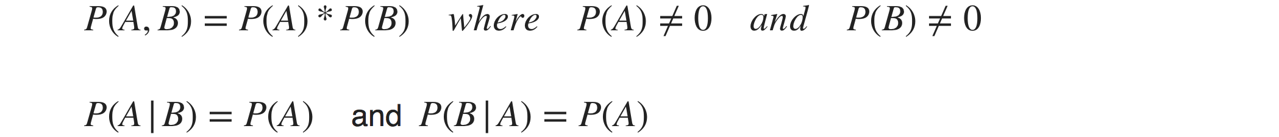

Two events are said to be independent of each other, if the probability that one event occurs in no way affects the probability of the other event occurring, or in other words if we have observation about one event it doesn’t affect the probability of the other. For Independent events A and B below is true
Example Let’s say you rolled a die and flipped a coin. The probability of getting any number face on the die is no way influences the probability of getting a head or a tail on the coin.

Slide 70


Slide 71


Slide 72
Bayes’ Theorem Problems
Example : the Medical Test
1% of people have a certain genetic defect. 90% of tests for the gene detect the defect (true positives). 9.6% of the tests are false positives. If a person gets a positive test result, what are the odds they actually have the genetic defect?
The first step into solving Bayes’ theorem problems is to assign letters to events:
A = chance of having the faulty gene. That was given in the question as 1%. That also means the probability of not having the gene (~A) is 99%.
X = A positive test result.
So:
P(A|X) = Probability of having the gene given a positive test result.
P(X|A) = Chance of a positive test result given that the person actually has the gene. That was given in the question as 90%.
p(X|~A) = Chance of a positive test if the person doesn’t have the gene. That was given in the question as 9.6%
Now we have all of the information we need to put into the equation: P(A|X) = (.9 * .01) / (.9 * .01 + .096 * .99) = 0.0865 (8.65%).
The probability of having the faulty gene on the test is 8.65%.

Slide 73

Bayesian Spam Filtering
Although Bayes’ Theorem is used extensively in the medical sciences, there are other applications.
For example, it’s used to filter spam. The event in this case is that the message is spam. The test for spam is that the message contains some flagged words (like “lottery” or “you have won”). Here’s the equation read as “The probability a message is spam given that it contains certain flagged words”:
The actual equations used for spam filtering are a little more complex; they contain more flags than just content..

Slide 74
Example: dangerous fires are rare (1%)
but smoke is fairly common (10%) due to barbecues,
and 90% of dangerous fires make smoke
We can then discover the probability of dangerous Fire when there is Smoke:
P(Fire|Smoke) =P(Fire) P(Smoke|Fire)/P(Smoke)
=1% x 90%/10%
=9%
So it is still worth checking out any smoke to be sure.

Slide 75
Example: Picnic Day
You are planning a picnic today, but the morning is cloudy
50% of all rainy days start off cloudy!
But cloudy mornings are common (about 40% of days start cloudy)
And this is usually a dry month (only 3 of 30 days tend to be rainy, or 10%)
What is the chance of rain during the day?
We will use Rain to mean rain during the day, and Cloud to mean cloudy morning.
The chance of Rain given Cloud is written P(Rain|Cloud)
So let's put that in the formula:
P(Rain|Cloud) = P(Rain) P(Cloud|Rain)/P(Cloud)
P(Rain) is Probability of Rain = 10%
P(Cloud|Rain) is Probability of Cloud, given that Rain happens = 50%
P(Cloud) is Probability of Cloud = 40%
P(Rain|Cloud) = 0.1 x 0.5/0.4 = .125
Or a 12.5% chance of rain. Not too bad, let's have a picnic!

Slide 76


Markov Chain Examples

Slide 77
Music synthesis
C
0.6
0.7
0.1
0.4
Am
G
0.2
0.6
0.1
0.3
0.4
F
0.6
Chord progressions learned from large database of guitar tablature

Slide 78
Text synthesis
Jane Austen’s Novel Pride and Prejudice:
121,549 words
8,828 unique words (most common: ‘the’)
7,800,000 possible pairs of words
58,786 pairs (0.75%) actually appeared
most common pair?
Given a model learned from this text, we can
generate more “Jane Austen”-like novels
estimate the likelihood that a snippet of text was written by Jane Austen

Slide 79
Coke vs. Pepsi Example
Given that a person’s last cola purchase was Coke ™, there is a 90% chance that her next cola purchase will also be Coke ™.
If that person’s last cola purchase was Pepsi™, there is an 80% chance that her next cola purchase will also be Pepsi™.
0.9
0.1
0.8
coke
pepsi
0.2

Slide 80
Given that a person is currently a Pepsi purchaser, what is the probability that he will purchase Coke two purchases from now?
Pr[ Pepsi→ ? →Coke ] =
Pr[ Pepsi→Coke→Coke ] + Pr[ Pepsi→ Pepsi →Coke ] =
0.2 * 0.9 + 0.8 * 0.2 = 0.34
? → Coke
Pepsi → ?

Slide 81
Given that a person is currently a Coke purchaser, what is the probability that he will purchase Pepsi three purchases from now?

Slide 82
Assume each person makes one cola purchase per week
Suppose 60% of all people now drink Coke, and 40% drink Pepsi
What fraction of people will be drinking Coke three weeks from now?
Pr[X₃=Coke] = 0.6 * 0.781 + 0.4 * 0.438 = 0.6438
Q_{i} - the distribution in week i
Q₀=(0.6,0.4) - initial distribution
Q₃= Q₀ * P³ =(0.6438,0.3562)

Slide 83


Assume that, at that time, 80 percent of the sons of Harvard men went to Harvard and the rest went to Yale, 40 percent of the sons of Yale men went to Yale, and the rest split evenly between Harvard and Dartmouth; and of the sons of Dartmouth men, 70 percent went to Dartmouth, 20 percent to Harvard, and 10 percent to Yale. (i) Find the probability that the grandson of a man from Harvard went to Harvard. (ii) Modify the above by assuming that the son of a Harvard man always went to Harvard. Again, find the probability that the grandson of a man from Harvard went to Harvard.
Solution- We first form a Markov chain with state space S = {H,D,Y } and the following transition probability matrix :
H→H→H= 0.8*0.8 +
H→D→H=0*0.2 +
H→Y→Y=0.2*0.3 = 0.7

Slide 84

If all sons of men from Harvard went to Harvard, this would give the following matrix for the new Markov chain with the same set of states:
The upper-left element of P^2 is 1, which is not surprising, because the offspring of Harvard men enter this very institution only.

Slide 85
Hidden Markov Models - HMM
Hidden variables
H₁
H₂
H_{i}
H_{L-1}
H_{L}
X₁
X₂
X_{i}
X_{L-1}
X_{L}
Observed data

Slide 86
Coin-Tossing Example
Start
tail
1/2
1/2
1/2
tail
0.1
1/4
Fair
loaded
0.9
0.1
1/2
3/4
0.9
head
head
Fair/Loaded
L tosses
H₁
H₂
H_{i}
H_{L-1}
H_{L}
X₁
X₂
X_{i}
X_{L-1}
X_{L}
Head/Tail

Slide 87

HMM
Example Consider a room with N urns. Within each urn there are a large number of colored balls. We assume that there is M different colors in total. Furthermore, assume that an urn is initially chosen according to some probability distribution. From this urn, a ball is chosen at random, and its color is recorded as the observation. The ball is then replaced in the urn from which it was selected. A new urn is selected according to a random selection process associated with the current urn.

